Slide 1
Viewing
CPSC 453 - Fundamentals of Computer Graphics

Slide 2
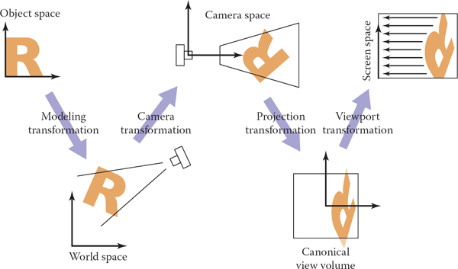

Slide 4
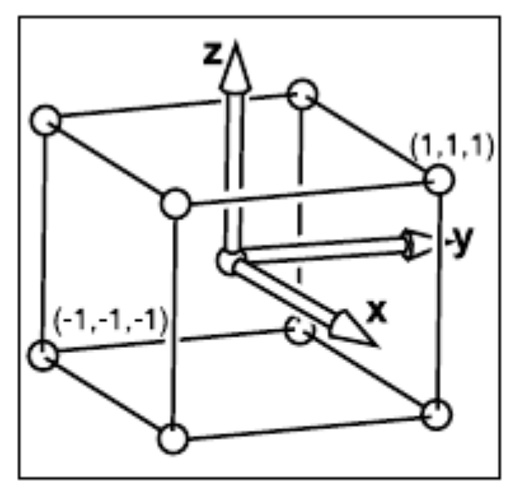
Normalized Device Coordinates (NDC) : [-1,1]³

Slide 5
Normalized Device Coordinates (NDC) : [-1,1]³

Slide 6
Scaling in 1D

Slide 7
Mapping in 1D

Slide 8
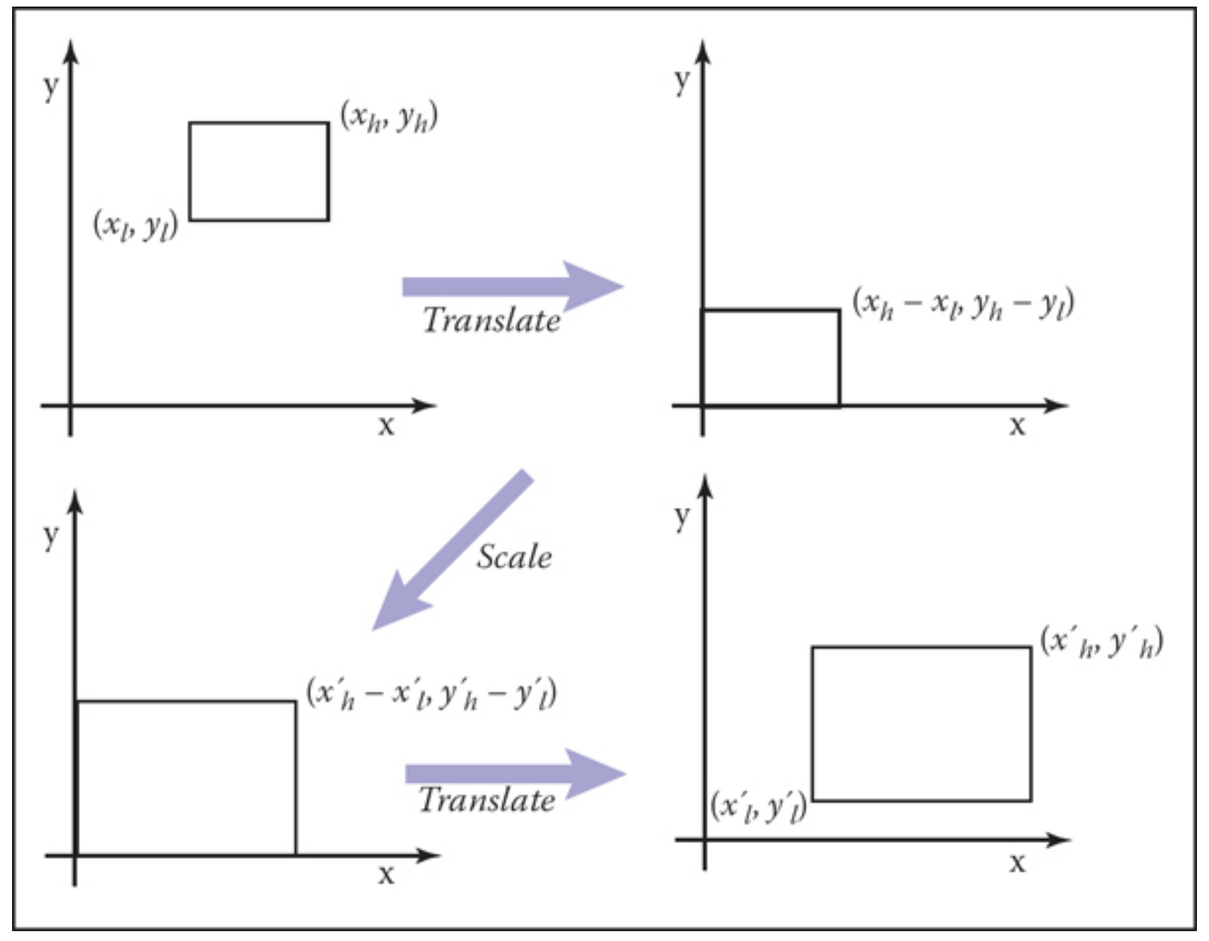
Mapping in 2D

Slide 9
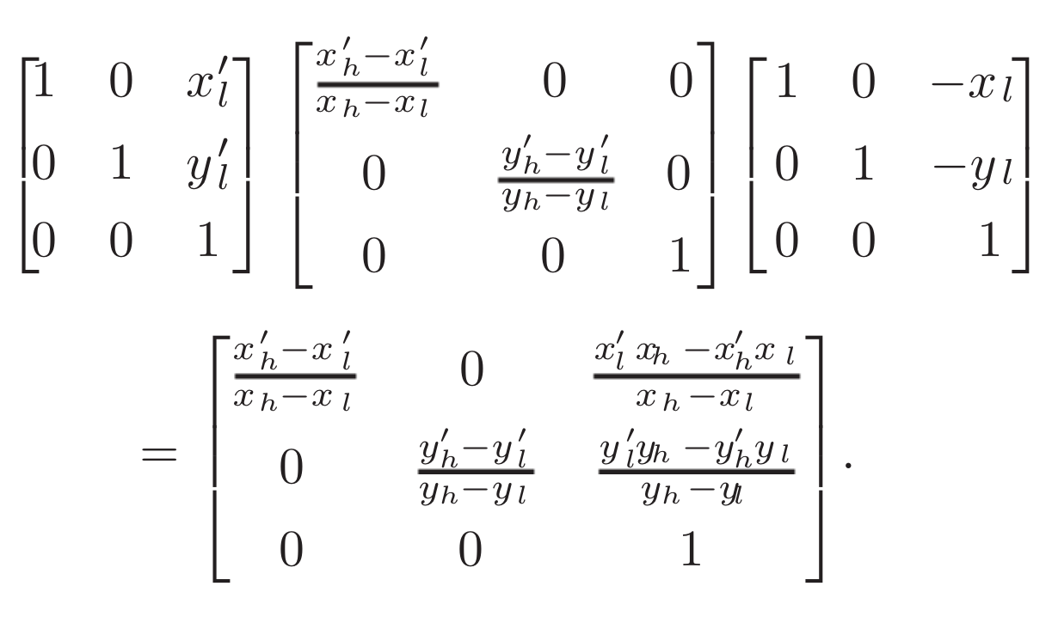
Mapping in 2D

Slide 10
2D mapping NDC to screen space
[-1,1]²
[-0.5, -n_{x} – 0.5] x [-0.5, -n_{y} – 0.5]

Slide 11
2D mapping NDC to screen space

Slide 12
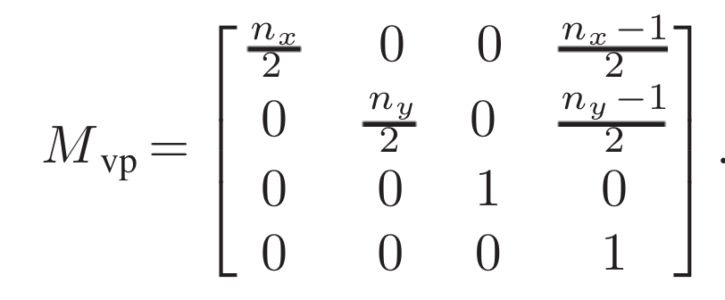
3D mapping: Viewport transformation

Slide 13
3D mapping: Viewport transformation
OpenGL does this automatically with the values set in
glViewport(x, y, width, height)

Slide 14
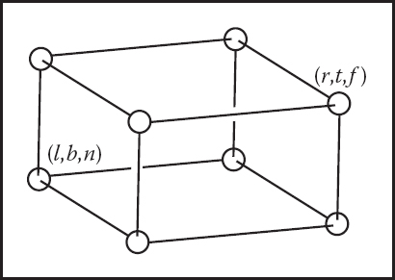
Orthographic view volume
NDC volume

Slide 15
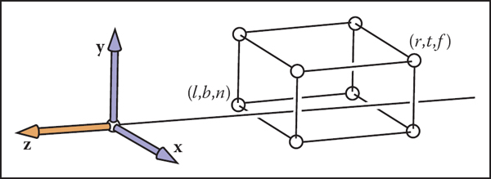
Orthographic view volume
Volume is along z-axis ( i.e. n > f )

Slide 16
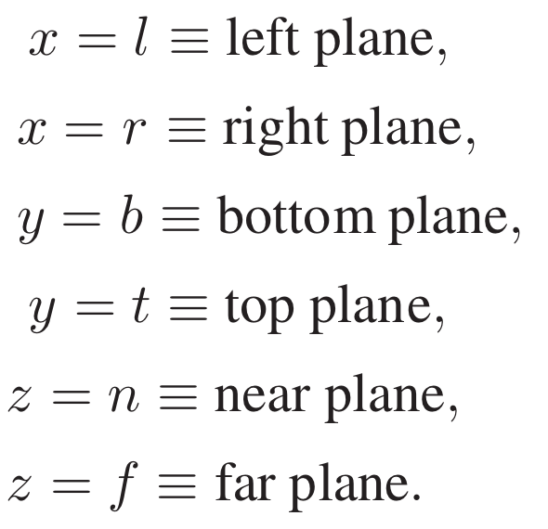
Orthographic view volume

Slide 17
Mapping one box to another…
Orthographic view volume
NDC volume

Slide 18
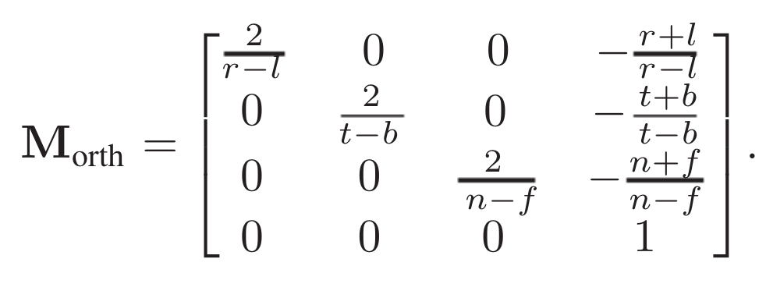
Mapping one box to another…
Orthographic view volume
NDC volume

Slide 19
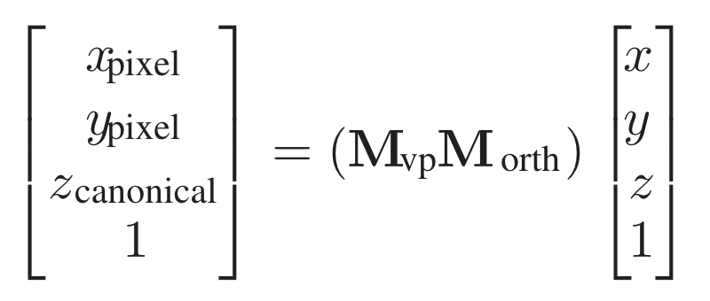
Orthographic view volume
NDC volume

Slide 20
Orthographic view volume
NDC volume
The z-coordinate is in [-1,1], and will be used for depth buffering later.

Slide 21
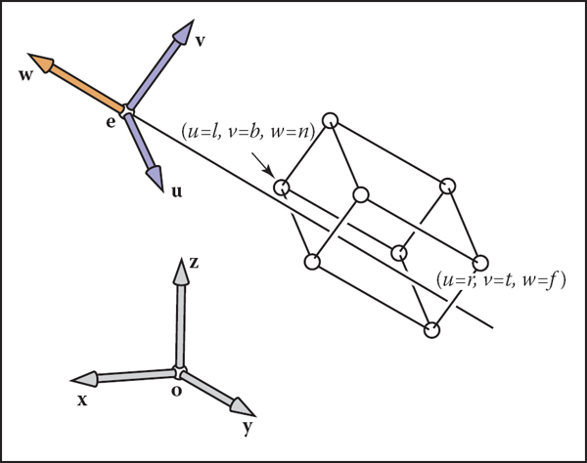
Camera transformation
Orthographic view volume
Arbitrary view transform

Slide 22
Camera transformation
Orthographic view volume
Arbitrary view transform

Slide 23
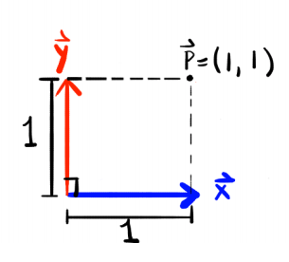
2D change of coordinates

Slide 24
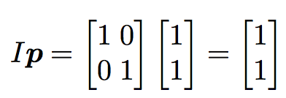
2D change of coordinates

Slide 25
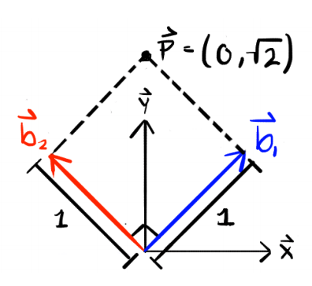
2D change of coordinates

Slide 26
2D change of coordinates
A matrix with columns that are mutually orthonormal, is a rotation matrix

Slide 27
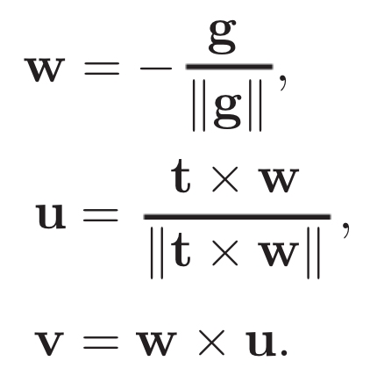
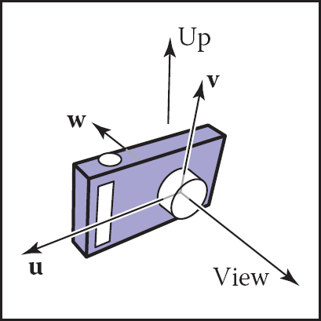
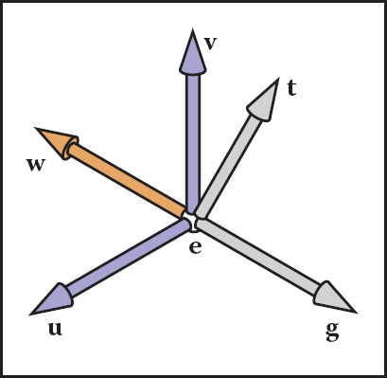
Camera transformation

Slide 28
Camera transformation
Orthographic view volume

Slide 29
World space to Screen space

Slide 30
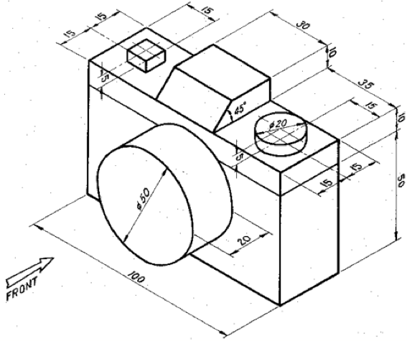
Isometric drawing (using Orthographic projection)

Slide 31
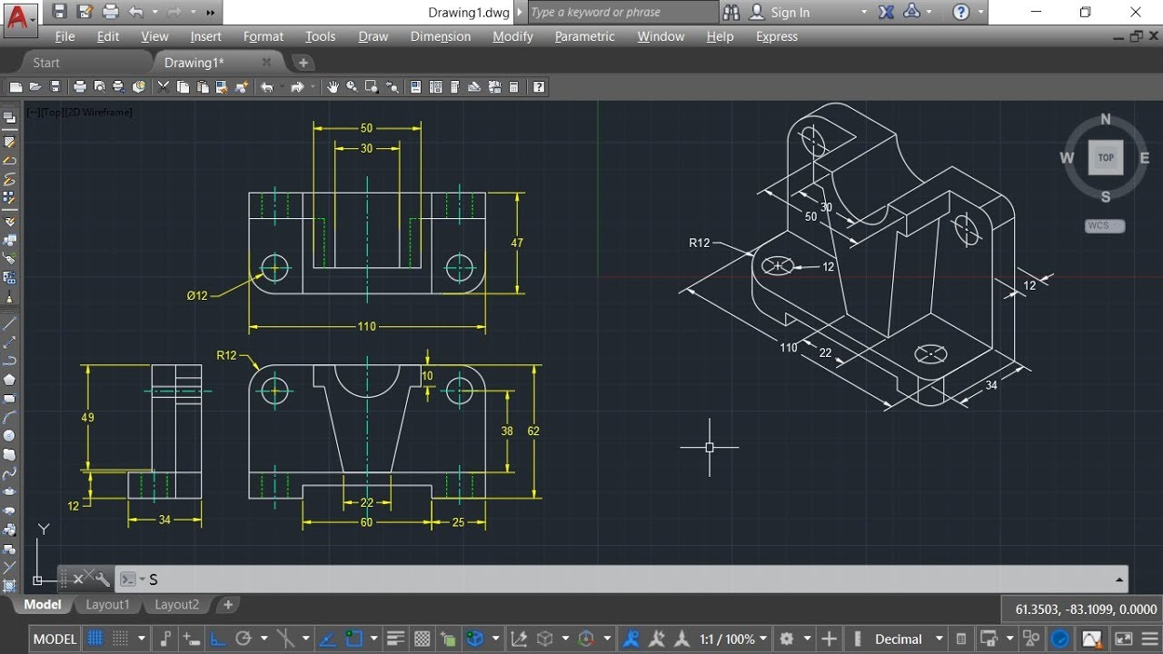

Slide 32
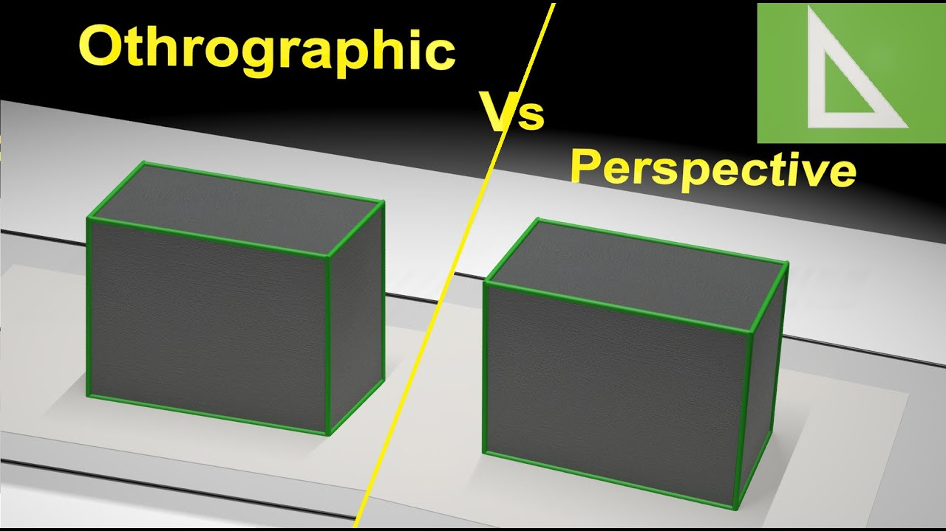
Next Week

