Slide 1
Examples of vectors and relations between them
Equal vectors
Different directions
Ending point (head)
S
Q
a
a
-a
b
Starting point (tail)
c
R
o
P
Free vector
Null vector
Equivalent
bound vectors
Opposite
orientation
(same attitude)
Different length
(magnitude)
represent

Slide 2
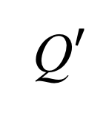
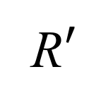
Interpretation of a vector as a translation of a rigid body
$$P′$$
$$a$$
Q$′$
$$a$$
$$P$$
R$′$
$$a$$
Q
$$R$$
$${\overset{⃑}{PP}}^{′}= {\overset{⃑}{QQ}}^{′}= {\overset{⃑}{RR}}^{′}=a$$

Slide 3
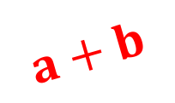
Definition of vector addition
$$b$$
$$a$$
$$a+b$$

Slide 4
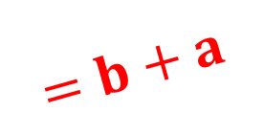
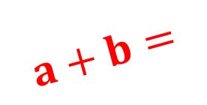
Commutativity of vector addition
$$b$$
$$a$$
$$a+b=$$
$$=b+a$$
$$a$$
$$b$$
a + b = b + a

Slide 5
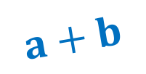
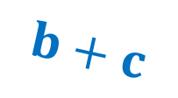
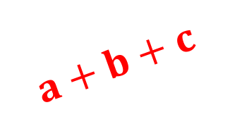
Associativity of vector addition
$$b+c$$
$$b$$
$$a$$
$$a+b+c$$
$$c$$
$$a+b$$
(a + b) + c = a + (b + c)

Slide 6
Multiplication of a vector by a scalar
$$a$$
$$2a$$
$$−2a$$
$$\frac{1}{2}a$$

Slide 7
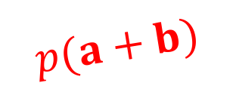
Distributive property
$$Q′$$
$$pb$$
$$pa$$
$$Q$$
$$a$$
$$b$$
$$R′$$
$$R$$
$$P$$
$$a+b$$
$$p(a+b)$$
p(a + b) = pa + pb
also (p+q)a = pa + qa

Slide 8
Definition of vector difference
$$b$$
$$a−b$$
$$a$$
$$a−b$$
-$b$
a - b = a + (-1)b

Slide 9
The usual construction of vector difference
$$b$$
$$a−b$$
$$a$$

Slide 10
Projection of a vector on a line
$$l$$
$$Q$$
$$Q′$$
$$a_{l}$$
$$a$$
$$P′$$
P

Slide 11
Distributive property
$$l$$
$$R′$$
$$R$$
$$b_{l}$$
$$b$$
$$Q$$
$${(a+b)}_{l}$$
$$Q′$$
$$a+b$$
$$a_{l}$$
$$a$$
$$P′$$
P
(a + b)_{l} = a_{l} + b_{l}

Slide 12
Calculating projection length
$$a$$
$$α$$
$$a_{l}$$
$$l$$
$$a_{l}=\left|a_{l}\right|=|a|\cos{α}$$

Slide 13
Cross product
(a)
$$b$$
$$\left|a×b\right|=\left|a\right|\left|b\right|sin{α}$$
$$α$$
$$a$$
$$a×b$$
(b)
$$b_{⊥}$$
$$b$$
$$\left|a×b\right|=\left|a\right|\left|b_{⊥}\right|$$
$$α$$
$$a$$
$$a×b$$
$$a×b=a×b_{⊥}$$

Slide 14
Toward a distributive property
$$b_{⊥}$$
$$b$$
$$a_{⊥}$$
$$a$$
$$a+b$$
$${(a+b)}_{⊥}$$
$$c$$
$$P$$

Slide 15
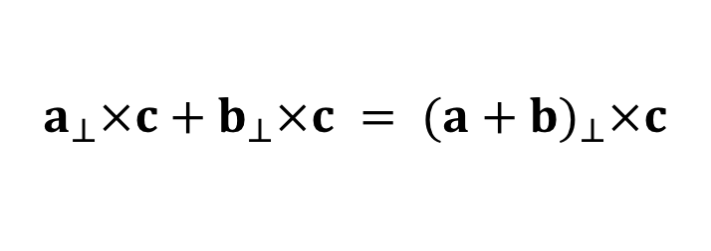
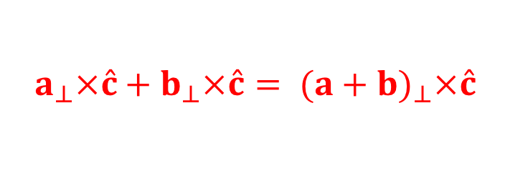
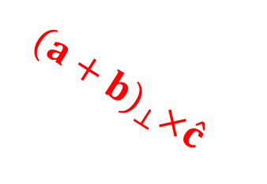
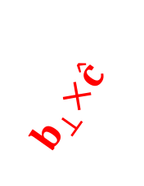
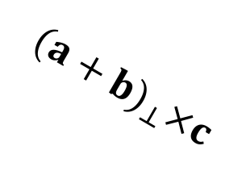
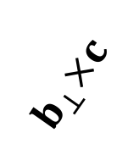
The distributive property
$${a_{⊥}×\hat{c}+b_{⊥}×\hat{c}= (a+b)}_{⊥}×\hat{c}$$
$${a_{⊥}×c+b_{⊥}×c = (a+b)}_{⊥}×c$$
$$b_{⊥}$$
a$×c+b×c=\left(a+b\right)$ $×c$
$$a_{⊥}$$
$$a_{⊥}×c$$
$$a_{⊥}×\hat{c}$$
$$c, \hat{c}$$
$$b_{⊥}×\hat{c}$$
$${(a+b)}_{⊥}×\hat{c}$$
$$b_{⊥}×c$$
$${(a+b)}_{⊥}×c$$

Slide 16
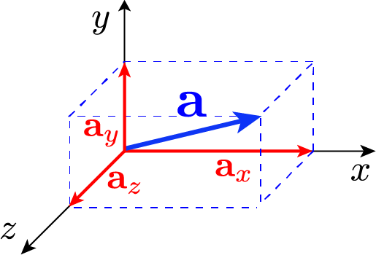
Vector in coordinates
a = a_{x} $\hat{i}$ + a_{y} $\hat{j}$ + a_{z} $\hat{k}$

